Slide 1
INSIDER THREAT AWARENESS
Combating the ENEMY Within
Mike Kalinowski
Facility Security Officer
iGov Technologies Tampa FL

Slide 2
Insider Threat Briefing
Purpose of Briefing
What is an Insider Threat?
Milestones
Training Requirements
Risk Categories
Red Flags
Reportable Behaviors
Insider Threat Impact
13 Adjudicate Guidelines
Actual Insider Threat #1 and #2

Slide 3
Purpose of this Briefing
A company can often detect or control when an outsider (non-employee) tries to access company data either physically or electronically, and can mitigate the threat of an outsider stealing company property.
However, the thief who is harder to detect and who could cause the most damage is the insider—the employee with legitimate access. That insider may steal solely for personal gain, or that insider may be a “spy”—someone who is stealing company information or products in order to benefit another organization or country.

Slide 4
What is an Insider Threat?
An Insider Threat is any person with authorized access to any U.S. Government resources, including personnel, facilities, information, equipment, networks, or systems, who uses that access either wittingly or unwittingly to do harm to the security of the U.S.
Other insider threat concerns may include:
Criminal activity, including theft and fraud
Safety, including an active shooter incident
Financial harm to industry by stealing unclassified, but sensitive or proprietary information
This threat can include damage to the U.S. through espionage, terrorism, unauthorized disclosure of national security information, or through the loss or degradation of government, company, contract or program information, resources or capabilities

Slide 5
Insider Threat Program Milestones
Insider Threat Program Milestones
Must have a written program plan in place to begin implementing Insider Threat requirements no later than November 30, 2016
Self-certify to DSS that a written program plan is implemented and current
Designate an Insider Threat Program Senior Official (ITPSO)
Cleared in connection with the FCL and responsible for establishing and executing the Insider Threat Program
Identified as a KMP in e-Fcl
Must serve in a position within the organization that has the authority to provide management, accountability, and oversight to effectively implement and manage the requirements of the NISPOM related to the Insider Threat
The Insider Threat Program Senior Official may also serve as the FSO
Establish an Insider Threat Program Group (ITPG) from offices across the contractor’s facility, based on the organization’s size and operations (Security, HR, Legal, IT, etc.)
Monitor employee use of classified networks (EO-13587)(Presidential Memorandum – November 21, 2012)
Provide Insider Threat training for Insider Threat Program personnel and awareness for cleared employees
ITPSO
ITPWG
Awareness and training for all employees (cleared Personnel)

Slide 6
Insider Threat Program Training
Training on Insider Threat Program Management is required for all personnel assigned duties related to Insider Threat Program Management
Provide internal training for Insider Threat Program personnel that includes
Topics outlined in NISPOM 3-103a
Counterintelligence and Security Fundamentals including applicable issues
Procedures for conducting Insider Threat response actions
Applicable laws and regulations regarding
Gathering
Integration
Retention
Safeguarding
Use of records and data
Consequences of misuse of such information
Applicable legal, civil liberties, and privacy policies
After November 30, 2016, new personnel assigned duties related to the Insider Threat Program Management must complete the required training within 30 days of being assigned those duties

Slide 7
Insider Threat Program Training
Employee Awareness Training
Required for all cleared employees before being granted access to classified information
Annually thereafter
Must provide internal training programs that include, at a minimum, the topics outlined in NISPOM 3-103b
Current and potential threats in the work and personal environment
Importance of detecting potential Insider Threats by cleared employees and reporting suspected activity to the Insider Threat Program designee
Methodologies of adversaries to recruit trusted insiders and collect classified information (in particular within ISs)
Indicators of Insider Threat behavior and procedures to report behavior
Counterintelligence and security reporting requirements

Slide 8
Insider Threat Program Training
All cleared employees who are not currently in access must complete Insider Threat Awareness training prior to being granted access
Cleared employees already in access must complete Insider Threat Awareness training within 12 months of the issuance date of NISPOM Change 2 (No later than 31 May 2017)
Must create and maintain records of all employee Insider Threat Awareness program Initial and Refresher training
Must include Insider Threat Awareness in annual refresher training

Slide 9
Risk Categories
Need or desire for money
Conflicting ideologies
Psychological factors (adventure, excitement, ego)
Blackmail—Compromised reason for spying
Foreign Intelligence Entity (FIE) could place you in a compromising position due to existing vulnerabilities
Excessive gambling
Drug/Alcohol abuse
Adultery
Any illegal activity and use that would force someone to spy

Slide 10
Red Flags
Failure to report foreign travel or foreign contact
Seeking to gain higher clearance levels or accesses
Engaging in classified conversations without “need to know”
Working hours inconsistent with job assignments or insistence on working alone
Exploitable behavior traits
Repeated security violations
Attempting to enter restricted areas without access rights

Slide 11
Reportable Behaviors
Information Collection
Keeping classified materials in an unauthorized location
Attempting to access sensitive information without authorization
Obtaining access to sensitive information inconsistent with present duty requirements
Information Transmittal
Using an unclassified medium to transmit classified materials
Discussing classified materials on a non-secure telephone
Removing classification markings from documents
Additional Suspicious Behaviors
Repeated or unrequired work outside of normal duty hours
Sudden reversal of financial situation or a sudden repayment of large debts or loans

Slide 12
Reportable Behaviors
Additional Suspicious Behaviors
Attempting to conceal foreign travel
The above list of behaviors is a small set of examples
You should report any additional observed behaviors that may parallel or exceed the listed concerns
Not every person who exhibits one or more of these indicators is involved with illicit behavior, but most of the persons who have been involved with espionage were later found to have displayed one or more of these indicators/red flags

Slide 13
Insider Threat Impact
An Insider can have a negative impact on national security and industry resulting in
Loss or compromise of classified information
Loss of export controlled information
Loss of proprietary information
Weapons systems cloned, destroyed, or countered
Loss of technological superiority
Economic loss
Loss of life

Slide 14
How you can HELP
You and your colleagues are the first line of defense against insider threats
Help protect our national security by
Reporting suspicious behavior that may be related to a potential compromise of classified information
Be aware of the actions of those around you and report suspicious behaviors

Slide 15
13 Adjudicate Guidelines

Slide 16
Insider Threat Motto
IF YOU SEE SOMETHING
SAY SOMETHING

Slide 17
Actual Insider Threat #1

Slide 18
Actual Statements From Insider Threat #1
I put 2 people in a COMA before with my MMA
I have been shot before
I have been stabbed before in the shoulder
I THOUGHT ABOUT KILLING PEOPLE!!!!!!
I THINK ABOUT IT OFTEN!!!!!!
I’M NOT TRYING TO SCARE YOU BUT THIS IS HOW I THINK!!!!!!
NOBODY CAN HELP ME!!!!!!

Slide 19
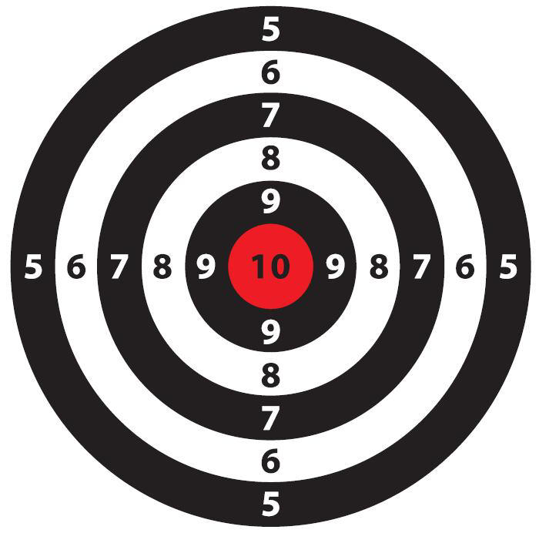
Actual Insider Threat #2

Slide 20
Actual Insider Threat #2 Background
Bullseye with picture of Program Manager
Put a Dart in Eye of Program Manager
This reference is better know in the Military Community as the KILL SHOT
Really brings this to light is the Individuals Military Background!!
Former Special forces while in the Military
SNIPER!!!!!!!!

